Slide 1
Topic: Investigation 1
EQ: How can I plan for and undertake the investigation on the Robot water bottle?

Slide 2
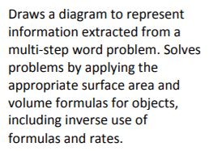
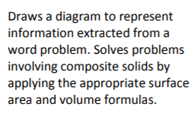
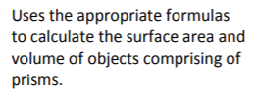

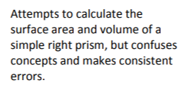

Slide 3
Spend 5 mins reading through this task- no questions or calling out during this time.
2. Planning sheet
I NEED TO…
On your planning sheet write down in 2 sentences what you are being asked to do
TOOLS:
Identify the resources that you have worked on in class that can help you complete this task?
REQUIRMENTS
Identify the key directions on the task sheet that you need to follow
WHAT WILL MY FINAL COPY HAVE WHEN I HAND IT IN
FIRST SKETCH AND MEASURMENTS

Slide 4
Planning sheet
I need to …
Tools: | What will my final copy include when I hand it in:
Requirements: | Draft 1: (First sketch and measurements)

Slide 5
 | 5 marks | 4 marks | 3 marks | 2 marks | 1 mark
Uses and communicates correct formula to calculate surface area Draws a diagram that meets the requirements of the drink bottle design | Correct formula stated Clear intermediary steps included Uses area and TSA formulas correctly Diagram must contain cubes, rectangular prisms, triangular prisms and cylinders Includes correct units on diagram Clear and neat diagram shows measurements that meet requirements | Correct formula stated Most intermediary steps included Uses area and/or TSA formulas correctly Diagram must contain cubes, rectangular prisms, triangular prisms and cylinders Includes correct units on diagram Neat diagram shows measurements that meet requirements | Correct formula stated Limited intermediary steps included Minor mistake in the use of area and/or TSA formulas Diagram contains a selection of cubes, rectangular prisms, triangular prisms and cylinders Includes correct units on diagram Diagram shows measurements that mostly meet the requirements | Disjointed steps in communication Use of area formulas is incorrect/ not consistent Diagram only contains cubes or rectangular prisms Incorrect units on diagram Diagram does not meet the requirements | No communication provided No diagram/ incomplete diagram No units units on diagram
Uses and communicates correct formula to calculate volume and capacity | Correct formula stated Clear intermediary steps included Uses volume and capacity formulas correctly | Correct formula stated Most intermediary steps included Minor mistake in the use of volume and/or capacity formulas | Correct formula stated Limited intermediary steps included Minor mistake in the use of volume and/or capacity formulas | Disjointed steps in communication Use of volume and/ or capacity formulasformula is incorrect | No communication provided

